Slide 1

Embed messages into images
Final Project for Information Security 2
Suyog Swami

Slide 2
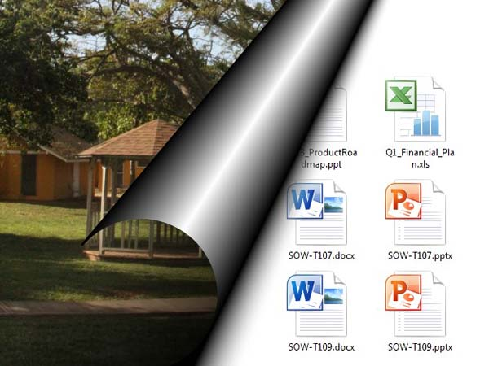
Overview
Steganography and its Types
Steganography and Encryption
Algorithm
Python for steganography
Modifications and improvements
Uses
Conclusion
Steganography using Image as the media

Slide 3
Introduction
What is Steganography
Greek Word
Steganos : covered, concealed or protected
Graphien: writing
Hidden Writing
Embedding
Art and science of hiding messages inside another message or media files

Slide 4
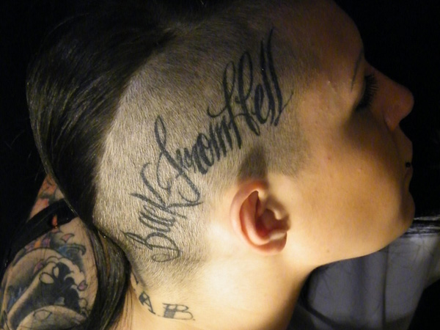
First Steganography
First Examples dates as back as during Ancient Greece
Histiaeus, as a prisoner of a rival king, needed to communicate a secret message to his own army.
Histiaeus shaved the head of a willing slave and tattooed his message on the scalp.
Once the slave’s hair had grown back, he was sent to deliver the hidden writing in person.
Image Source: http://slodive.com/inspiration/weird-tattoos/

Slide 5
Types of steganography
Depending on Stego-Objects
Audio files(Echo data hiding, Phase Coding)
Image Steganography
Video files (Eg. Steganosaurus by James Ridgway from University of sheffield)
Web steganography(spams)
DNA steganography(Secure printing)

Slide 6
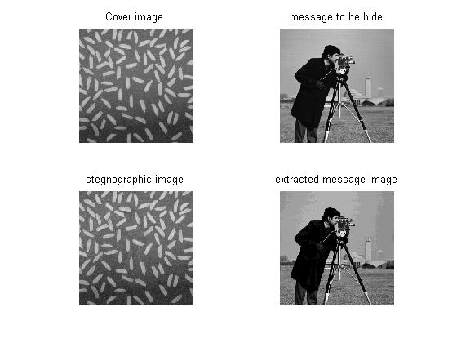
Steganography using Image as the media
Source: Matlab Central
Embedding text inside images
Such that the image before embedding and after embedding looks exactly alike
RGB color model?
HSL or HSV?

Slide 7
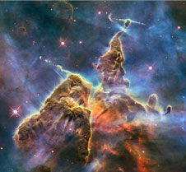
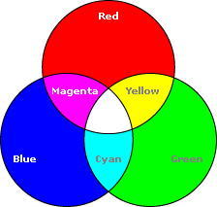
Steganography using Image as the media
What is the significance of the RGB?
How is RGB useful?
But is this safe?
How to make it safe?
from PIL import Image
im = Image.open('snapshot.jpg')
print(im.size)
pix=im.load()
print(pix[0,0])
(226, 209)
(98, 107, 104)

Slide 8
Steganography and Cryptography
Cryptography is used in situations where the existence of the message is clear, but the meaning of the message is obscured.
Steganography is used in situations where the actual existence of the message needs to be obscured.
Can these two practices be combined??
More Protection ??

Slide 9
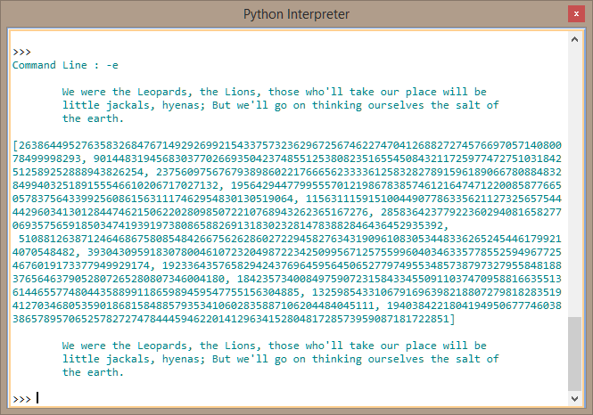

Algorithm
Encryption : RSA
Asymmetric Encryption
2 Keys: Public and Private
It is not possible to calculate these factors for numbers greater than 768 bits.

Slide 10
Algorithm
Convert Message to Cipher text using RSA
Convert Image into 2D array containing RGB values of each pixel.
Start from a predetermined pixel position.
Iterate through the image from that particular pixel position.
Iterate through the cipher text checking two digits of the text .
If digit is less than 64 convert it to binary

Slide 11
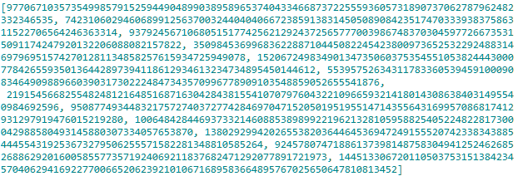
Algorithm continue…
The binary conversion of the decimal number will be a six bit binary value
Divide the 6 bits into group of 3 i.e 2 bits each
Replace its 2 bits at LSB of R – G – B pixel values each.

Slide 12
Algorithm continue…
Select the next pixel position using the value replaced at ‘B’ of previous pixel
Go to the next pixel and repeat same steps as before.
Problem??
What if the number of pixels end??
A normal 512 * 512 dimension image has in total 262144 pixel position
So there are enough pixels to fill and still many remain unchanged
How will the embedded image look like: Demo ?

Slide 13
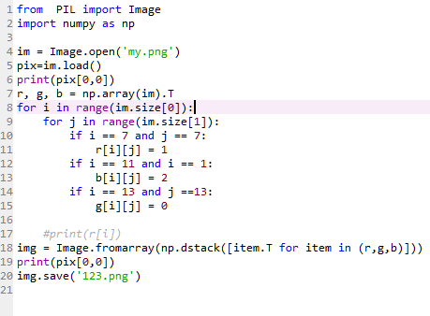


Image Processing

Slide 14
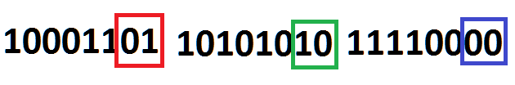
Extract Plus Decryption
As we know the initial predetermined point of start
We start iterating from that point
We get the R-G-B value of the pixel.
Convert each value into binary
Extract the 2 LSB’s.
Form a 6 bit binary from the 2-2-2 bits
And get the cipher text
Then we convert the cipher text into its message using RSA decryption.

Slide 15
Modifications and Improvements
Use of extra bits of cipher text to replace RGB vales Eg. 3, 4 If the message is big.
Use of different images types: PNG, GIF, JPG, JPEG??
Use of image with large pixel size
Use of modulo(find number of pixels to skip by taking mod of the pixel position)
Use of image having more than 3 pixel dimensions other than RGB?? Remember HSL

Slide 16
Python Version and Libraries
Pillow 2.8.1
Numpy 1.9.0
Python 3.4.1
Anaconda(spyder IDE)

Slide 17
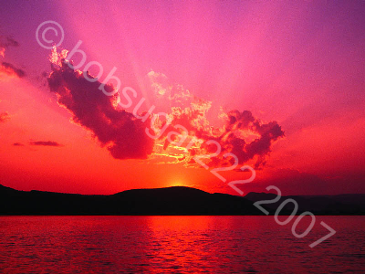
Uses
Watermarking
Source: http://www.codeproject.com/Articles/17346/Using-Trigonometry-and-Pythagoras-to-WaterMark-an

Slide 18
Uses
Sending texts where existence of messages needs to be kept secret
Spam messages where the names and the prices of certain drugs are made to appear on the screen using stenographic techniques in conjunction with the rendering of HTML text.
In particular, the images of the letters and numbers that appear on the screen are constructed by carefully arranging the positions of very large numbers of very small characters.
Video steganography

Slide 19
Conclusion
Implement Steganography to embed message in an image.
Encrypt and decrypt the message before and after steganography respectively.
Use modifications by changing the pixel positions.
Study the changes in the image if we embed a large text message inside a small image

Slide 20
Reference
http://www.developer.com/java/ent/article.php/3530866/Steganography-101-using-Java.htm
http://www.itworld.com/article/2826840/crash-course-digital-steganography.html
http://stackoverflow.com/questions/2659312/how-do-i-convert-a-numpy-array-to-and-display-an-image
http://waprogramming.com/download.php?download=50af5d0d652e21.01234314.pdf
http://slodive.com/inspiration/weird-tattoos/
http://www.steganosaur.us/
http://www.codeproject.com/Articles/17346/Using-Trigonometry-and-Pythagoras-to-WaterMark-an
https://mukarrammukhtar.wordpress.com/rsa-in-java/

Slide 21
